Slide 1
determining the location and orientation of webcams using natural scene variations
Nathan Jacobs
Notes:
My talk is very related to today’s colloquium talk given by my advisor, Dr. Pless
I’d like to start with a brief transition from his talk to mine

Slide 2
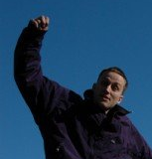
Let’s use webcams for science.
Let’s learn some things about the cameras first.
Notes:
If you missed his talk this cartoon provides a good summary.
My talk today will be about work that supports this idea.

Slide 3
Where is the webcam?
given only a webcam’s URL
What direction is it pointing?
Notes:
I will present our work on answering two questions…
The answers will be useful because webcams are uncalibrated sensors.

Slide 4
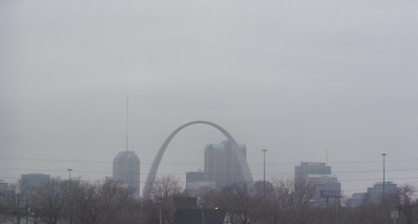
Where is this webcam?
What direction is it pointing?
Notes:
Answering these questions for some webcams is easy.
For example…
The problem is that most webcams aren’t this easy.

Slide 5
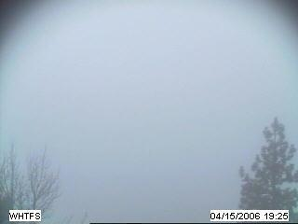
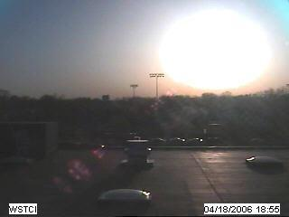
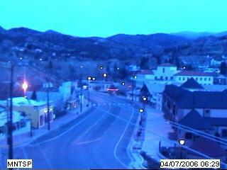
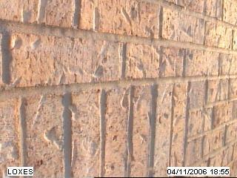
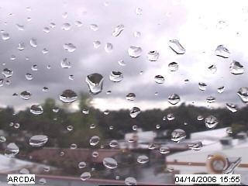
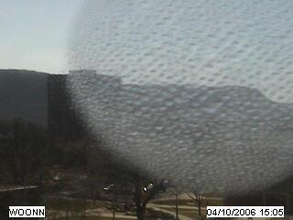
Where are these webcams?

Slide 6
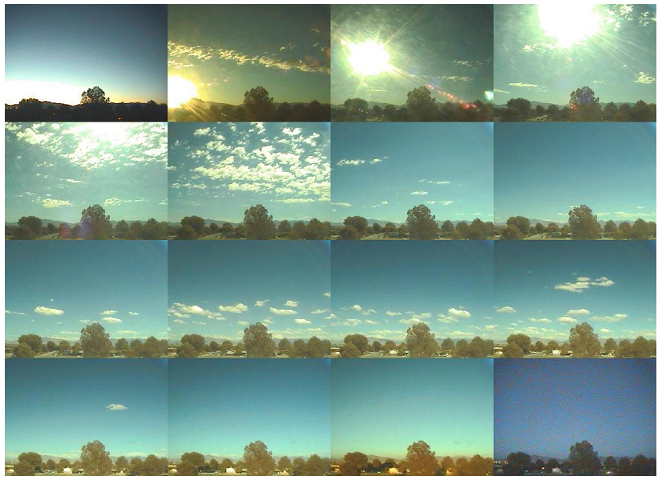
our idea: use many images
Notes:
natural scene variations provide …

Slide 7
talk overview
our test dataset of webcam images
examples of natural scene variations
method for determining location
method for determining orientation

Slide 8
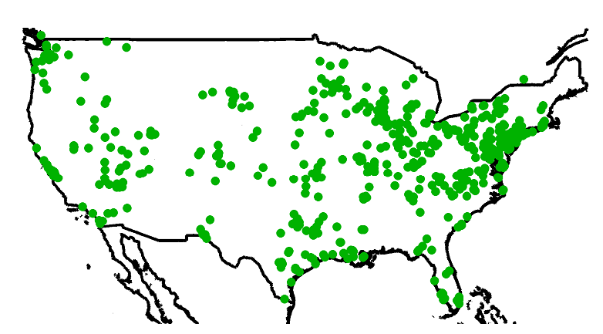
our test dataset: the archive of many outdoor scenes
1000 webcams
x 3 years
39 million images
many examples of how
the appearance of the world changes over time

Slide 9
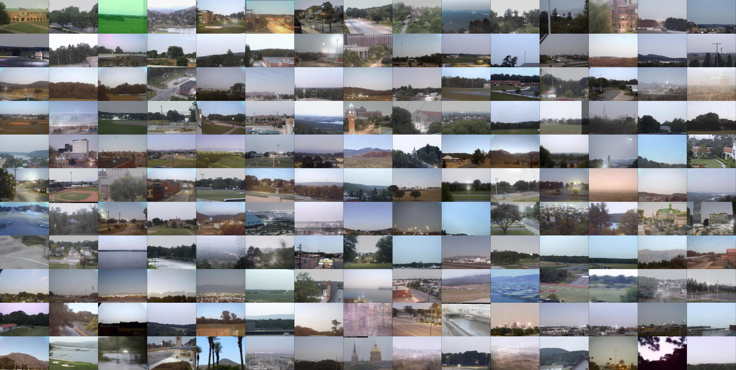

Slide 10
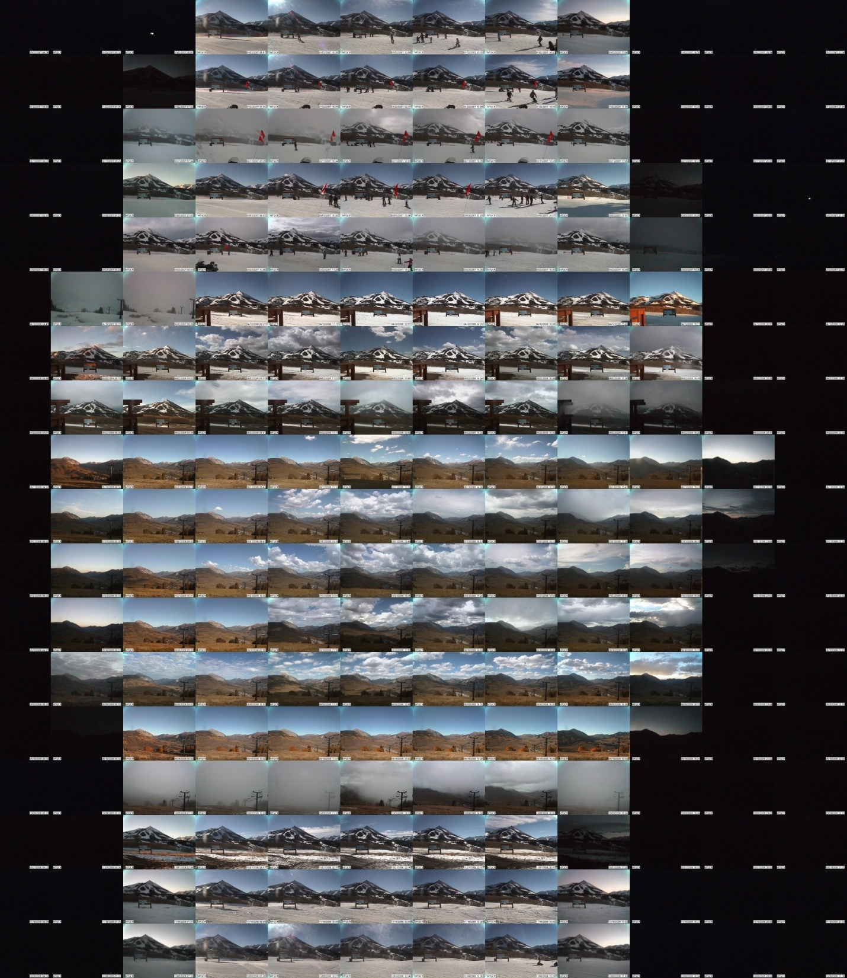
a year of
images
from one
webcam

Slide 11
examples of natural variations
daily variations
sunrise
noon
sunset

Slide 12
day to day variations

Slide 13
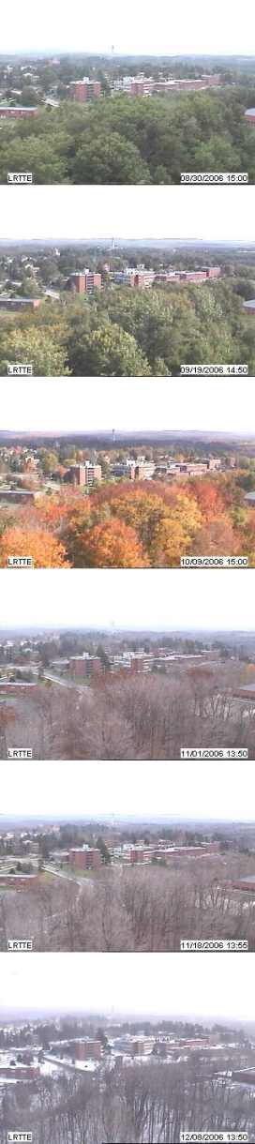
seasonal variations
Notes:
in the dataset we can also observe variations at much longer time scales
the rest of this talk explores how to use the fact that the natural variations depend on the viewpoint of the observer

Slide 14
the webcam geo-localization problem
Given: a sequence of time-stamped images
Output: the geographic location of the camera
14

Slide 15
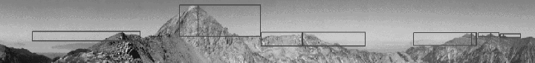
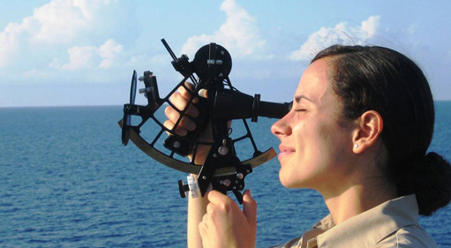
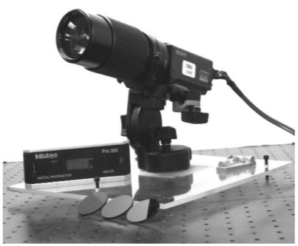
existing localization methods
static image features
tracking shadows cast on the ground
computer vision sextant
network address lookup

Slide 16
Our approach
use many images
extract time-series signals that correspond to the natural scene variations
use the fact that natural scene variations depend on location

Slide 17
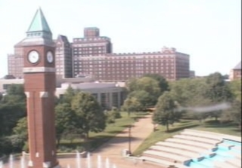
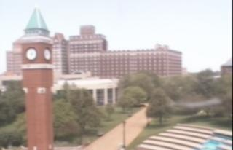
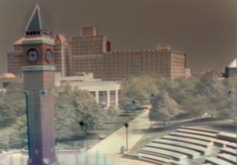
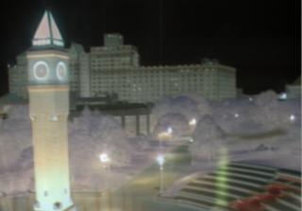
use PCA to convert images to
low-dimensional time-series
difference from mean at time t
= + f₁( t ) + f₂( t ) + ...
image at
time t
mean Image
component 1
component 2
coefficient 1
coefficient 2

Slide 18
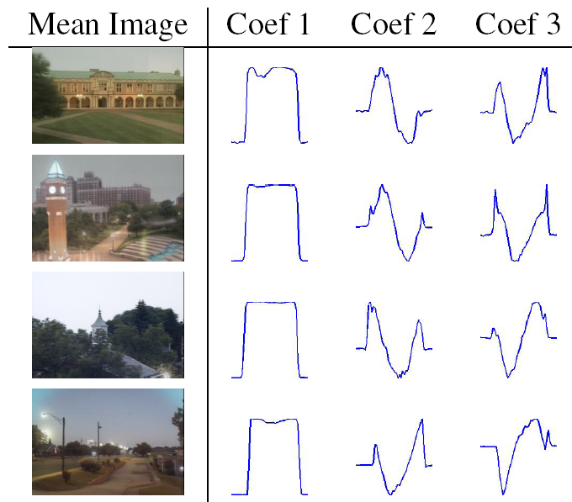
= + f₁( t ) + f₂( t ) + ...
mean Image
component 1
component 2
Camera 1
Camera 2
Camera 3
Camera 4

Slide 19
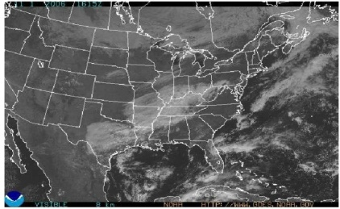
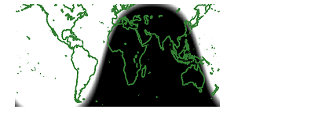
our geo-location algorithm
ICCV 2007
Compute PCA coefficients from some subset of images from the camera (~one month).
Create a geo-registered satellite map for each timestamp that we have an image.
Reconstruct the time-series of each satellite pixel linearly using the time-series of the leading PCA coefficients.
Choose the best: The map pixel with the lowest reconstruction error is the estimated location of the camera.

Slide 20
choosing the webcam images and the satellite maps
PCA on all images:
first coefficients depend on sun position
PCA on many days of images at noon:
first coefficients depend on weather conditions

Slide 21
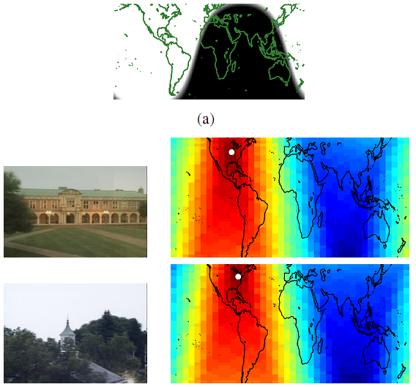
localization using sunlight images

Slide 22

localization using satellite imagery

Slide 23
the camera orientation problem
Given: a sequence of time-stamped images
Output: the geographic orientation of the camera

Slide 24
geo-orientation algorithm overview
WACV 2008
Assume that the camera location is known.
Find pixels that image sky.
Create synthetic hemispherical sky-appearance images.
Match sky pixels to synthetic sky-appearance model.

Slide 25
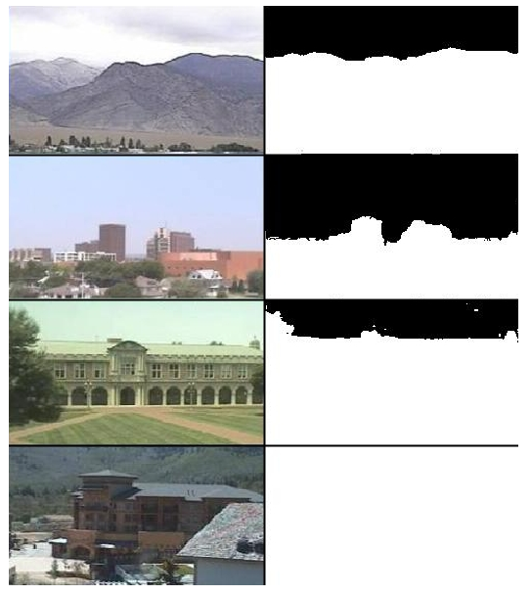
Step 1: Find sky pixels
Algorithm:
Solve for component images using PCA.
Threshold each pixel on the value of component 1.

Slide 26
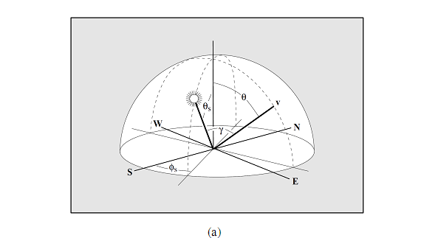
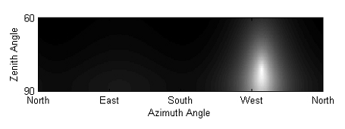
Step 2: creating synthetic sky image
For each time we have an image:
compute sun direction
(we know time and location)
create synthetic sky image
(using analytical model)
Preetham et al. “A practical model for daylight”, SIGGRAPH ’99.

Slide 27
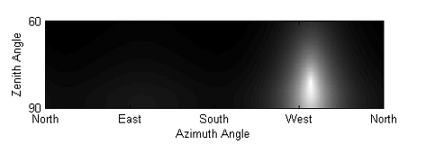












simulated
rectangular sub-images

Slide 28
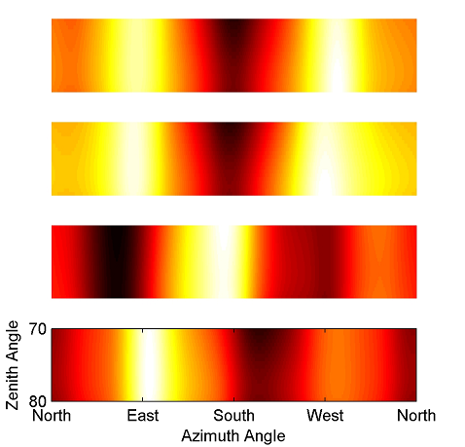
Step 3: computing match score
Compute normalized cross-correlation between pairs of synthetic and real sky image.
Average the results.
Westward facing camera
Same camera, sun images dropped
South facing camera
East facing camera

Slide 29
Conclusions
Natural variations are a strong cue for location and orientation.
We have automated methods of using these cues.
Future work
estimate scene structure
estimate other camera parameters
use cameras for science

Slide 30
Thanks
Collaborators
Robert Pless
Nathaniel Roman
Scott Satkin
Walker Burgin
Richard Speyer
Partially supported by NSF Career award IIS-0546383
Image credits
Bernie Bernard TDI-Brooks International, Inc.

